Slide 1
Data Analytics bootcamp Monday - Day 2
Dr. Michael Salé – Winter 2018

Slide 2
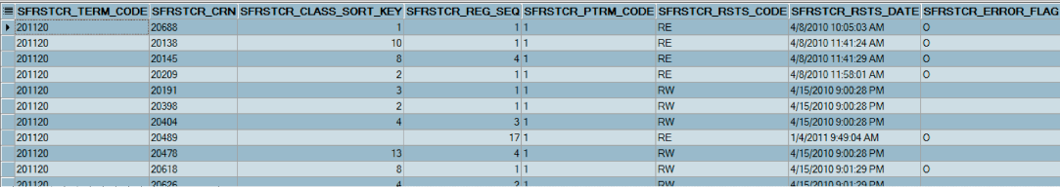
Data is not actionable
Any type of business decision requires knowledge about the given situation.
Before any type of decision can be made, we have to turn the data that we have freely available, into something that we can understand.
Only after we understand the data (by some type of processing, summarization, etc.), can we make “data-backed” business decisions.

Slide 3
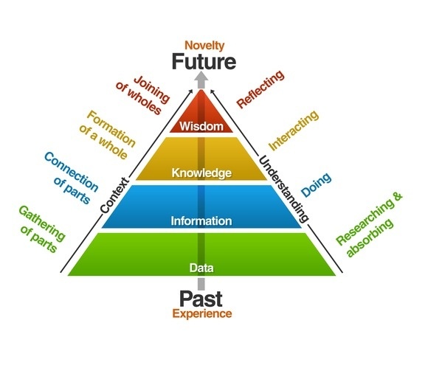
Data transformation

Slide 4
Importance of converting data into actionable knowledge
If we take too long to perform the analysis on our data, we miss out on important opportunities.

Slide 5
How much data we we produce?
Every day we create 2.5 quintillion bytes of data
This would fill 10 million blu-ray discs, the height of which stacked, would measure the height of 4 Eiffel Towers on top of one another.
90% of the world’s data was created within the last 2 years alone!
Everything you do creates data
Browsing the Internet
Watching TV
Streaming Netflix
Using apps
Talking to Siri, Echo, or Alexa
Playing video games
Sending email
Making a purchase
Walking!!

Slide 6
Data volume
How often do you think the following about of data is produced? Every…
Month
Week
Day
Hour
Minute

Slide 7
Class activity
Imagine that you are going on a vacation to the Bahamas!!
You decide to use Orbitz.com to book your flight.
You search for a flight and decide to book a specific round trip next Monday.
In your groups, create a list of data points you create from the moment you click on the flight that you want to book, to the moment your plane touches down back in Boston when your vacation is finished.
Only list flight-related data, nothing about hotels, or your time in the Bahamas.

Slide 8
Data varies in structure

Slide 9
Structured(ISH) data types

Slide 10
Sources of data
Much of the data we create is transactional and recorded by transaction processing systems.
Much of it is subject-oriented data from functional area information systems.
Data comes from many different sources:
Can we brainstorm 20, 30, 40, 50 sources of data?
What percentage of the data generated do you think is structured versus unstructured?

Slide 11
Data problems
Since our data is coming from multiple sources, we have some major issues when we try to bring this data into one place to perform analytics:
Accuracy and quality
Completeness (null values)
Varying formats / localizations
Encryption / special characters
Wicked poor spelllign / slang / grammah
Validity
Relatability (poor linkage between data sources)
Capture latency (timelieness?)
Cross sectional / time series
Noise

Slide 12
Can imperfect data still make good predictions? A cost/benefit

Slide 13
Data preparation
Cleaning your messy data and solving the aforementioned problems are just part of preparing your data for analysis.
In some cases, analysis is impossible without proper preparation.

Slide 14
Data Preparation workshop
Topics we will cover (skills we will try):
Reshaping data tables (long versus wide)
Joining, subsetting, and filtering
Discuss missing data strategies

